Slide 1







LAYERED vs MODULAR vs MICROSERVICE
Which one is best for you?
Download the Presentation
Halil İbrahim Kalkan
Co-Founder & Software Architect | Volosoft
hibrahimkalkan
hikalkan

Slide 2

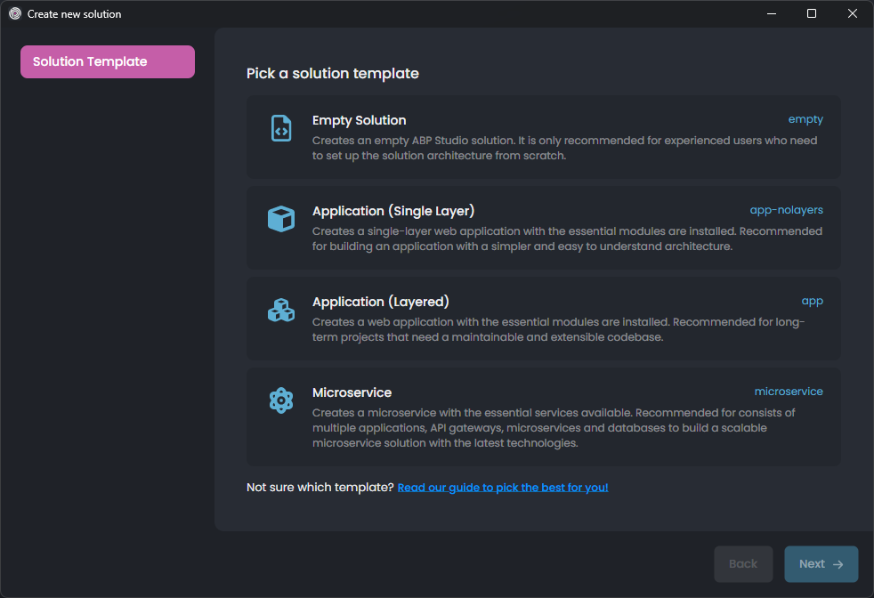
What is an ABP Startup Template?
Pre-architected solution structure
Well-structured code organization
Library integrations & configurations
Pre-integrated ABP modules & themes
Mobile application & public website options
Multiple Database & UI Options
Production Ready

Slide 3
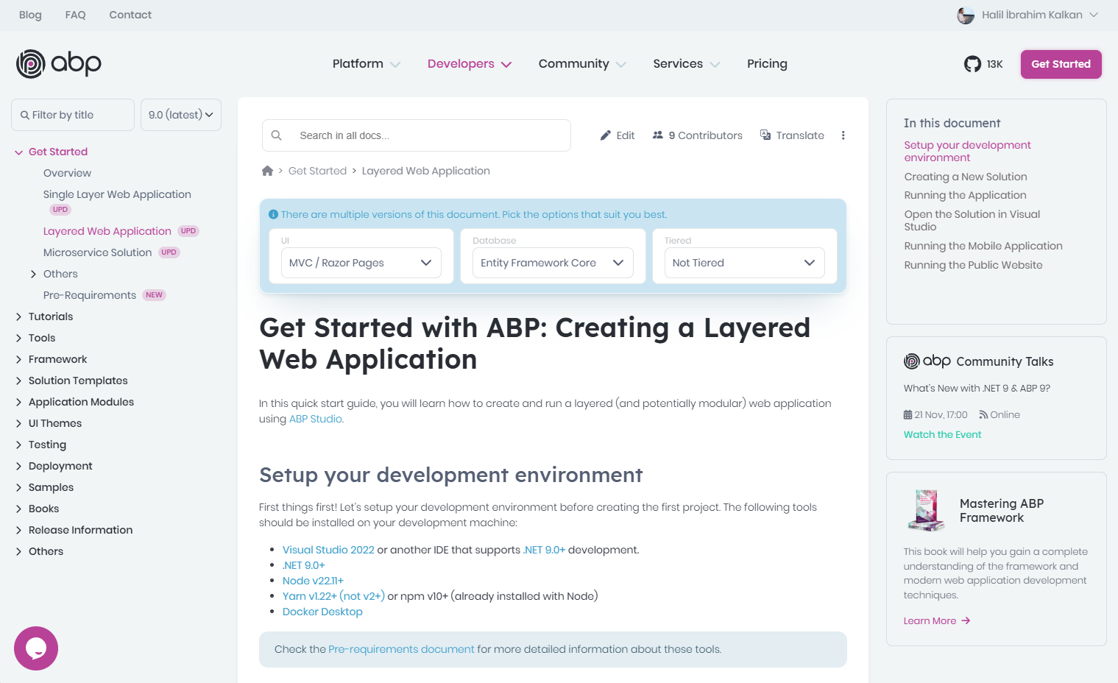
Documentation
Getting Started Create & run a solution
Tutorial Develop an application
Solution Structure All details of the solution
DEMO

Slide 4

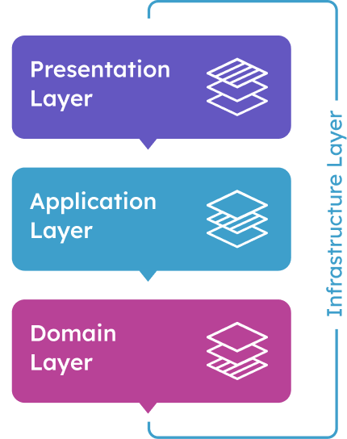
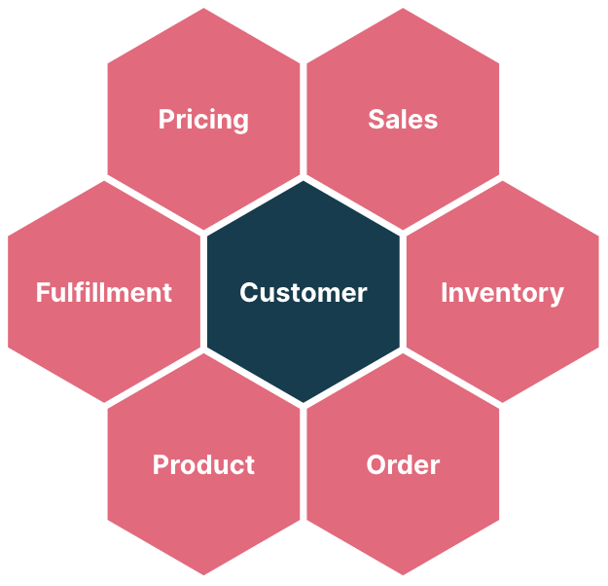
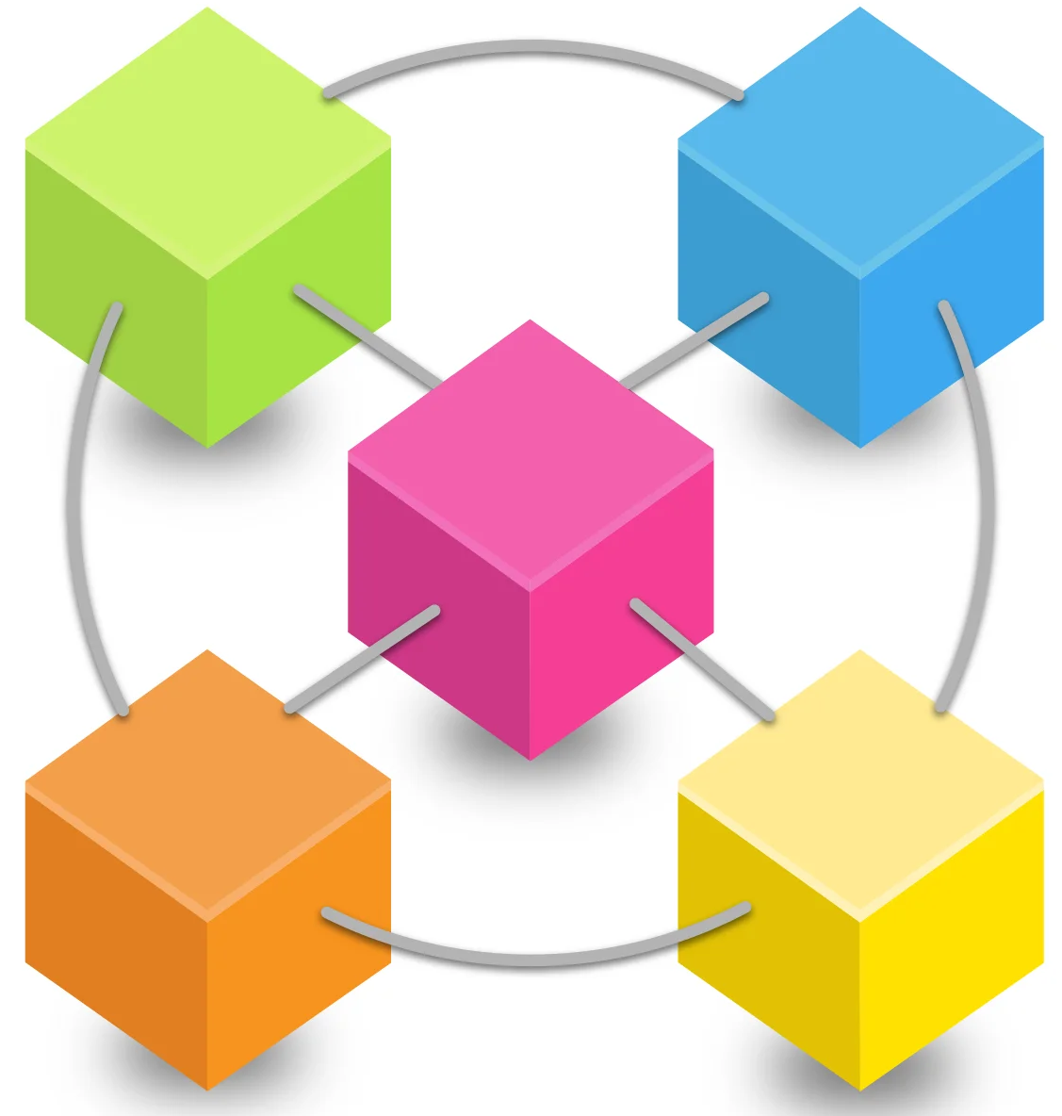
The Startup Templates
Single-Layer (non-layered) monolith application
N-Layered monolith application
Modular monolith application (based on Single-Layer or N-Layered applications)
Microservice solution

Slide 5
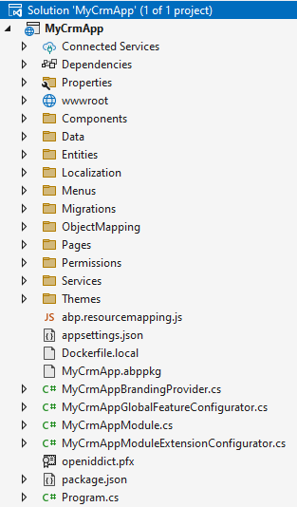
SINGLE-LAYER MONOLITH APPLICATION
The solution structure:
Single (or minimum number of) .NET projects (.csproj)
Code organized by folders/namespaces
When to start with?
Small project
Temporary project
Single, or a few developers
DEMO

Slide 6
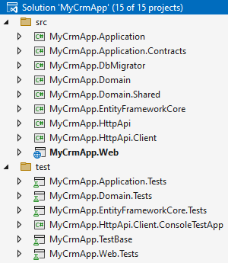
N-LAYERED MONOLITH APPLICATION
The solution structure:
Multiple .NET projects
Layered based on;
DDD principles
Sharing contracts with clients
Sharing business logic among applications
Includes Test projects for each layer
When to start with?
Larger & more complex code-bases
Long-term maintained projects
A team of developers
Multiple applications (mobile, web, background services, etc) share the same business logic
DEMO

Slide 7
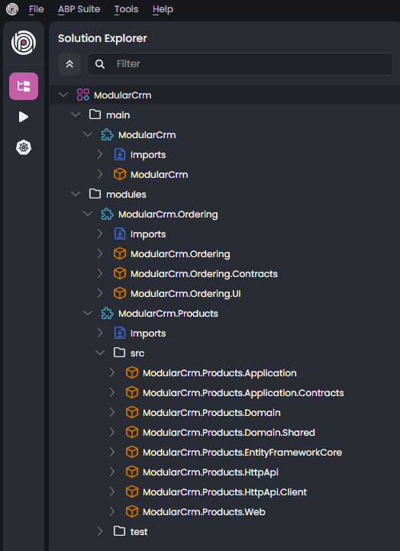
MODULAR MONOLITH APPLICATION
How to build?
Start with one of;
Single-Layer Application
N-Layered Application
Use ABP Studio to;
Install existing (pre-built) modules
Create new modules
Establish relations between the modules
When to start with?
Complex domain with sub-domains
Multiple teams
Migrate to microservices later
Need to scale the database (with database per module approach)
DEMO

Slide 8
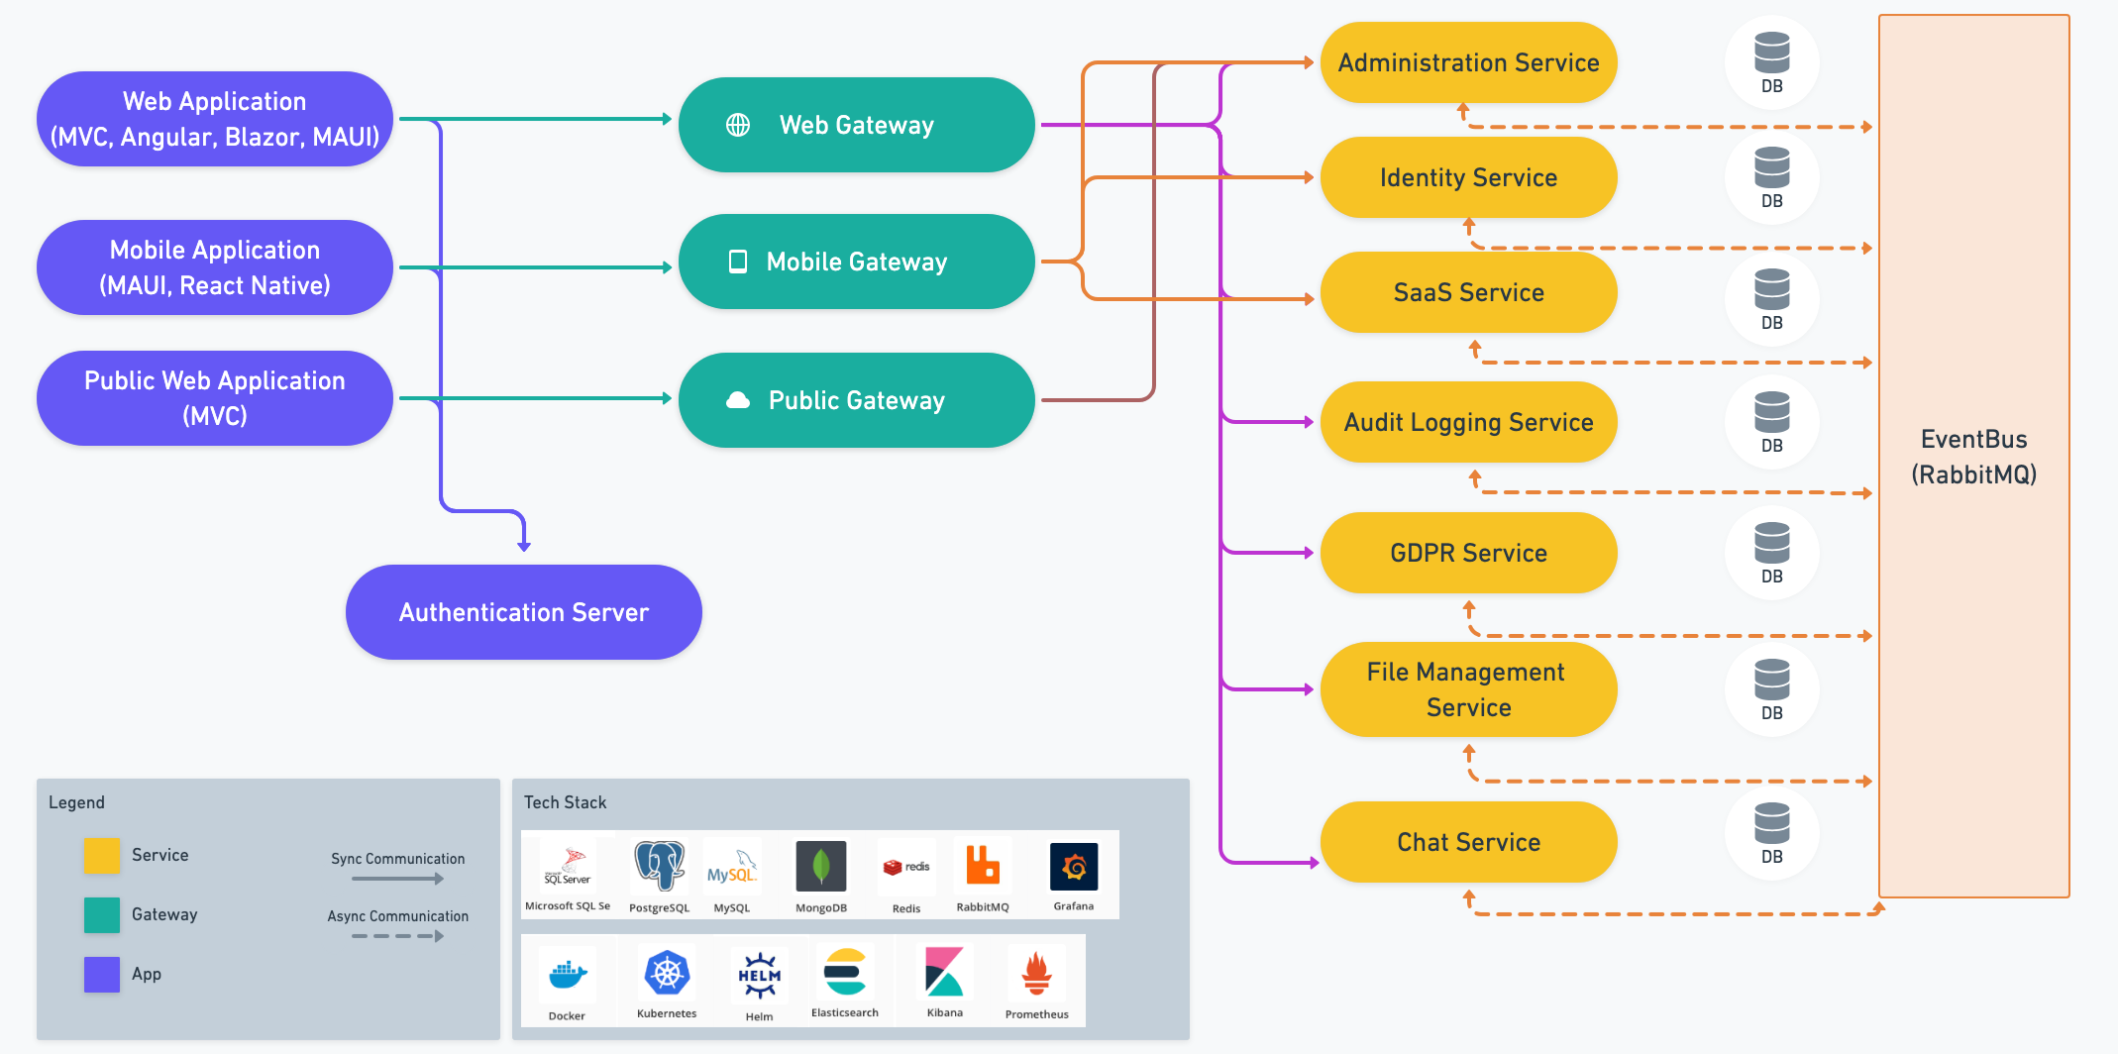
MICROSERVICE SOLUTION

Slide 9
MICROSERVICE SOLUTION
When to start with?
Complex domain with sub-domains
Multiple teams
Need to deploy and scale services, applications and databases independently
Need to use multiple technology stacks
Build a high available and fault tolerant system
Have a good DevOps culture
DEMO

Slide 10
Which Architecture?
single-layer
n-layer architecture
modular monolith
microservices
Small project
Temporary project
A few developers
Middle-size project
Long-term project
A team of developers
Multiple applications
Complex domain
Multiple sub-domains
Multiple teams
Scalable codebase
Scalable performance (on multiple databases)
Complex domain
Multiple sub-domains
Multiple teams
Large company & budget
Devops culture
Scalable codebase
Scalable performance
Multiple technology stacks
Targeting too many users
- High availability
- Fault tolerance - Independent scale
%5-10
%50-60
%20-30
%5-10

Slide 11
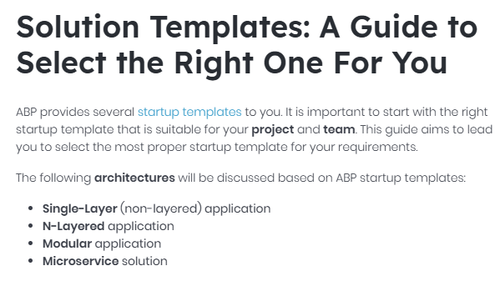

DOC: TEMPLATE SELECTION GUIDE
Read the Document

Slide 12
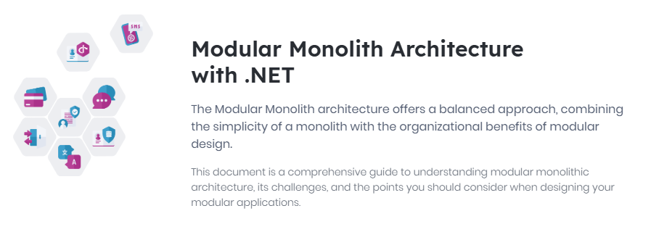

DOC: Modular Monolith Architecture with .NET
Read the Document

Slide 13


MONOLITH FIRST -> MICROSERVICE
Watch the Video

Slide 14
THANKS FOR
LISTENING
Download the Presentation
Halil İbrahim Kalkan
Co-Founder & Software Architect | Volosoft
hibrahimkalkan
hikalkan

